Slide 1

Chat GPT:
Prompting by Example

Slide 2
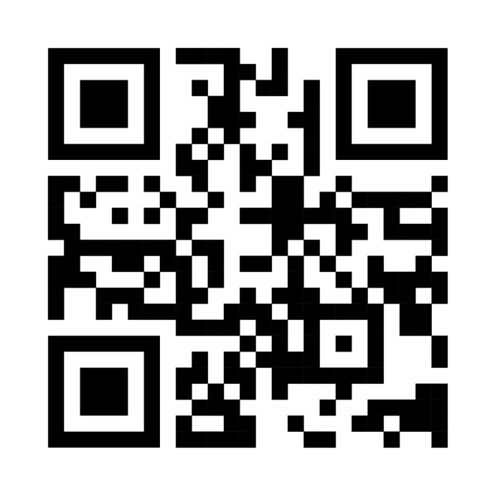
Slides and resources on Github!
What we’ll cover
What is a GPT Anyway?
Key terms and concepts
Strengths and weaknesses
Prompt Engineering approaches
A few projects
Beyond the “chat”

Slide 3
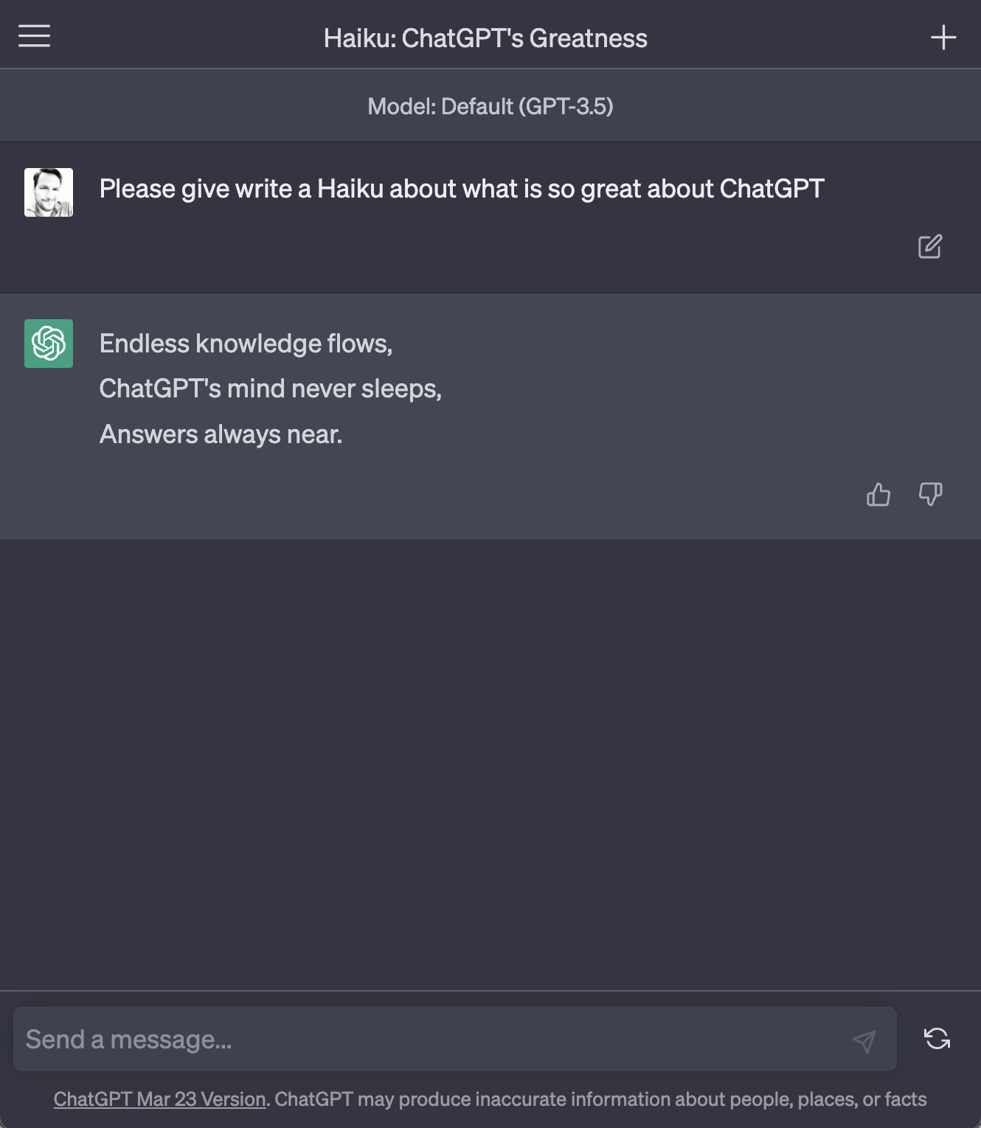
What is Chat GPT?
Generative Pre-trained Transformer (GPT) + Reinforcement learning from human feedback (RHLF)
A next-word predictor. Imagine a robot that read the whole internet, then was trained to have conversations about it.
3

Slide 4
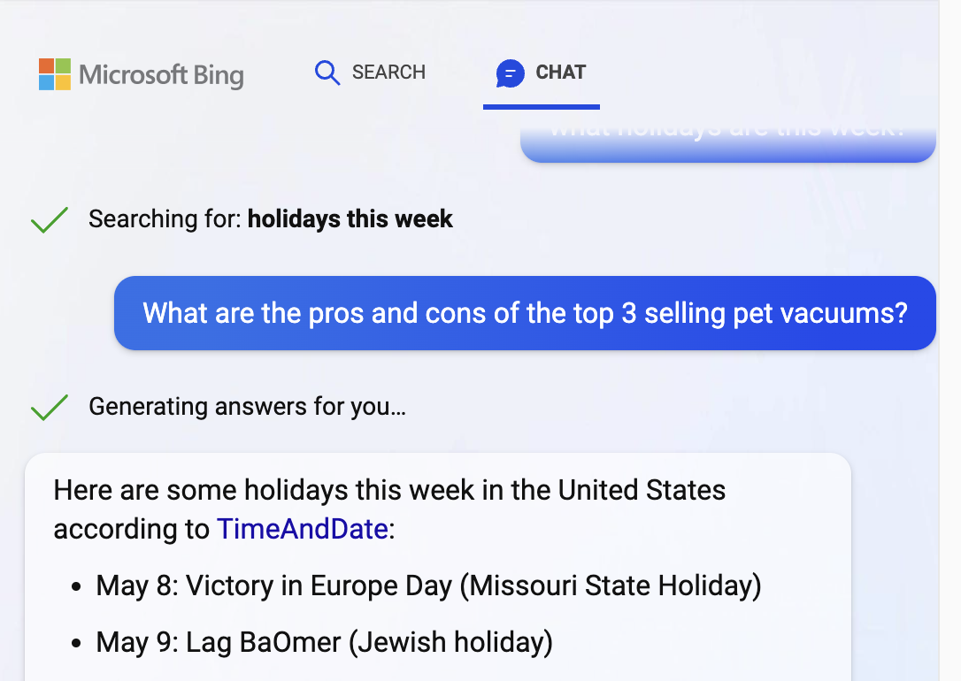
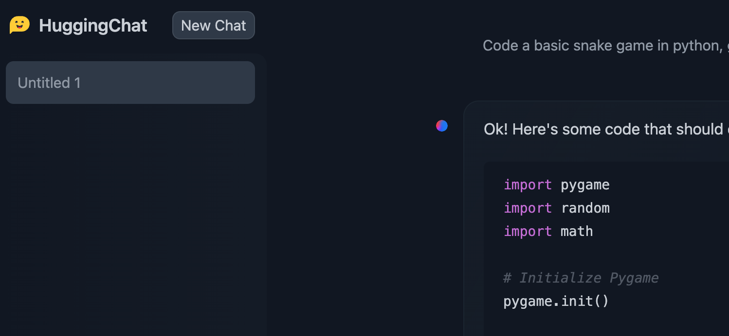
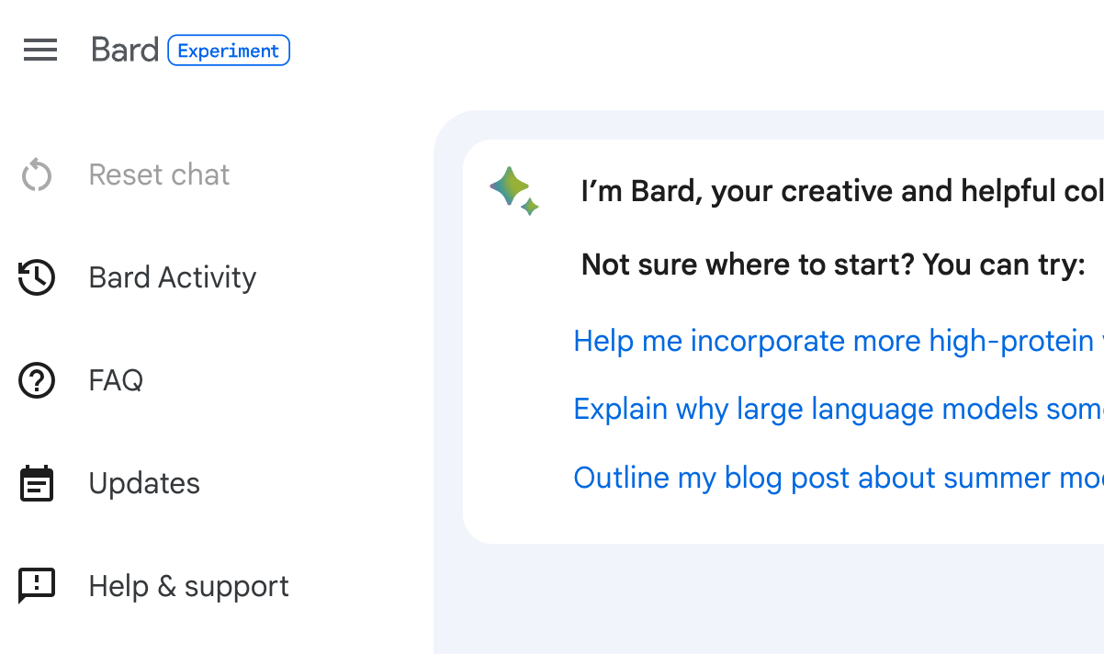
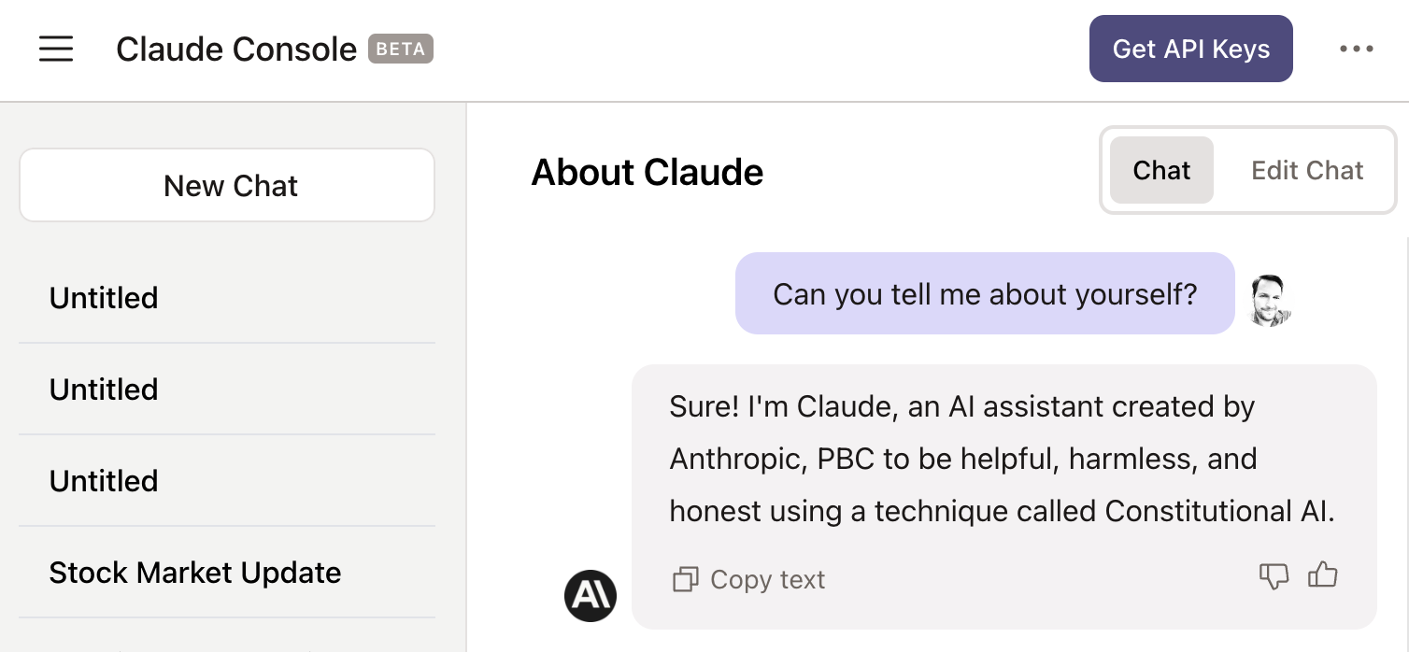
Oh, and there’s more!

Slide 5
02
Key Terms & Concepts
A quick glossary

Slide 6
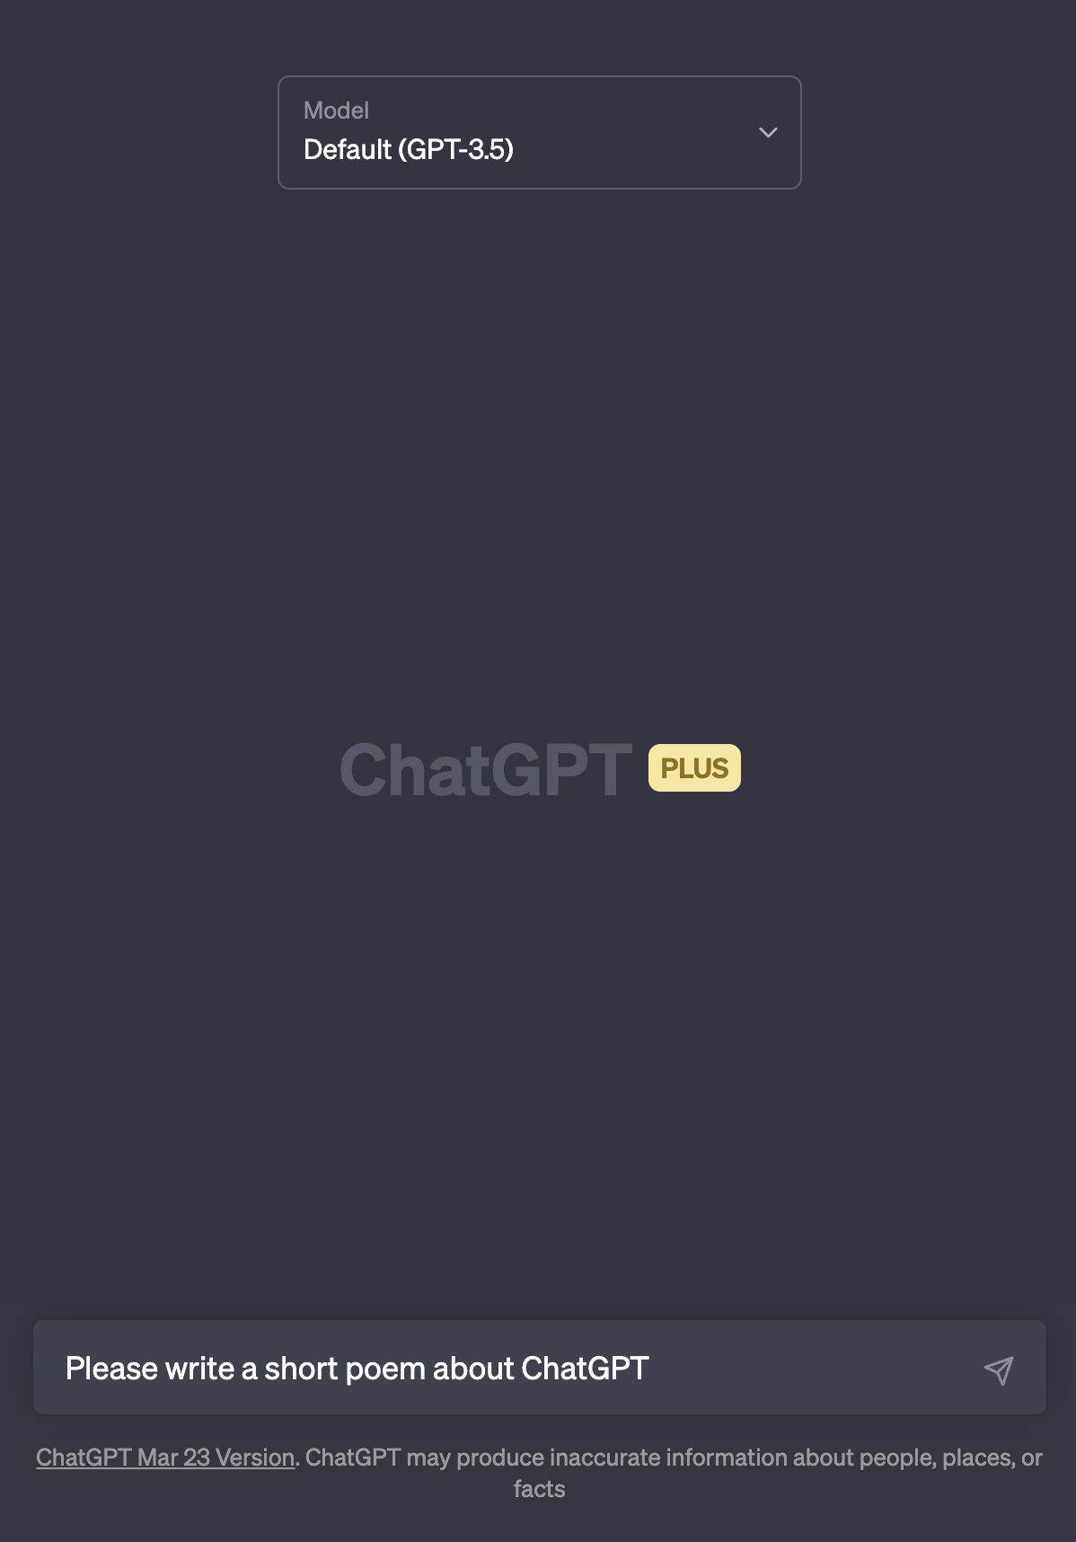
Prompt
A Question or Instruction, formulated as a chat message.
For “chat” GPT at least

Slide 7
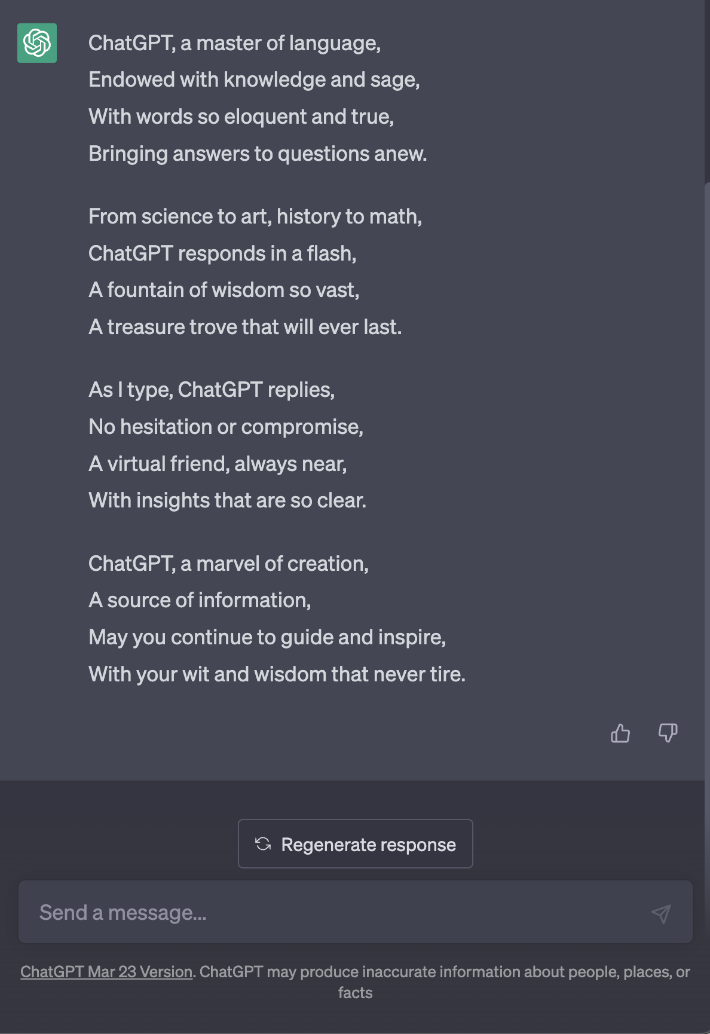
Response
Chat GPT starts giving a response, one word at a time, based on the prompt.
7

Slide 8
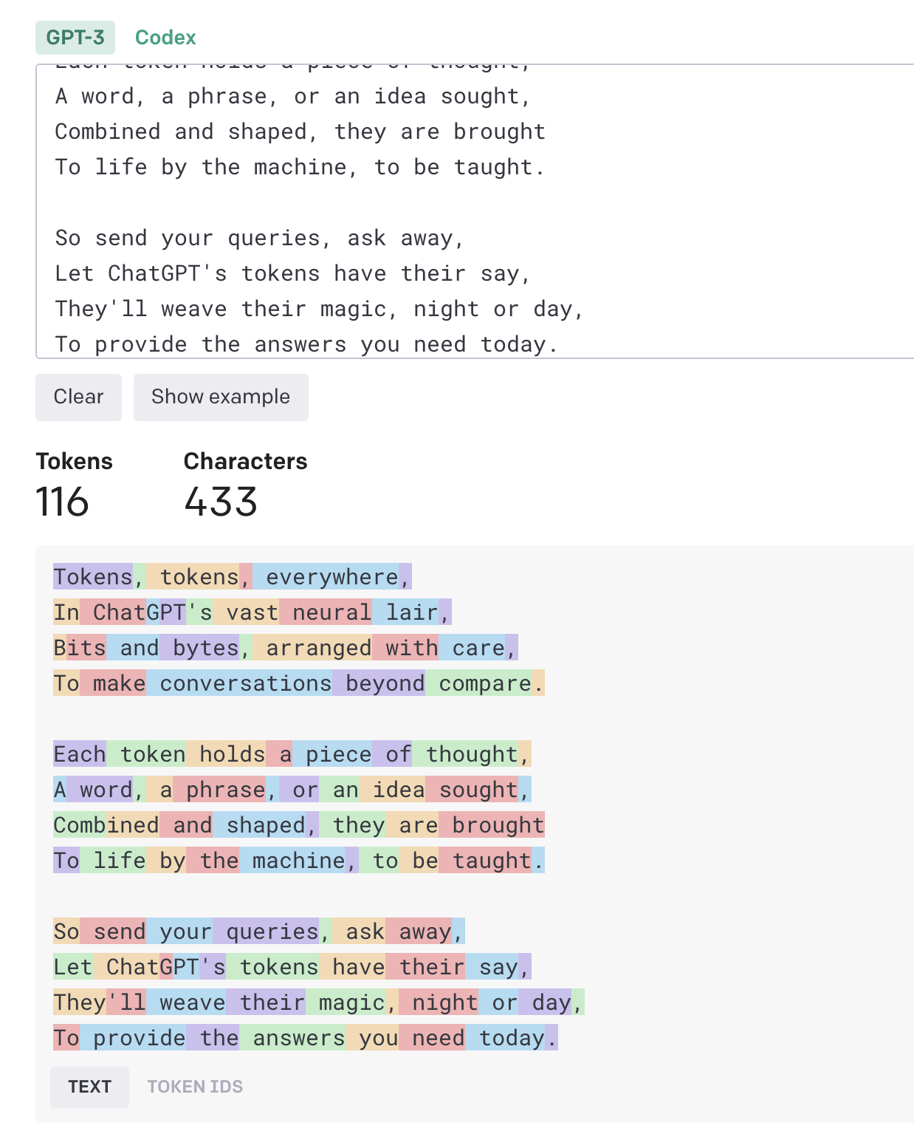
Token
https://platform.openai.com/tokenizer
A Token is the unit GPT ”thinks” in
A helpful rule of thumb is that one token generally corresponds to ~4 characters of text for common English text. This translates to roughly ¾ of a word (so 100 tokens ~= 75 words).
8

Slide 9

Context
Window
Different models support different amounts
GPT-4: 8,000 or 32,000 tokens
GPT-3.5: 4096 tokens
Claude: 100,000 tokens
9

Slide 10
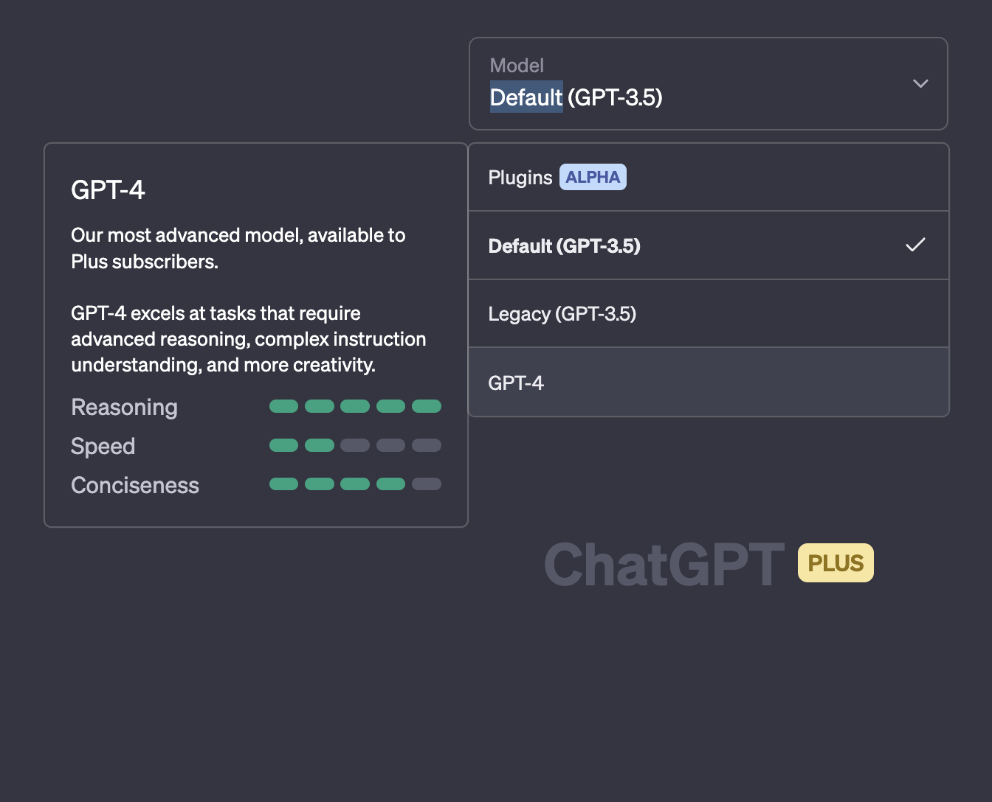
Model
Lots of models are out there from OpenAI and others.
Models are pretty much fixed once created, but they can be fine tuned in various ways.

Slide 11
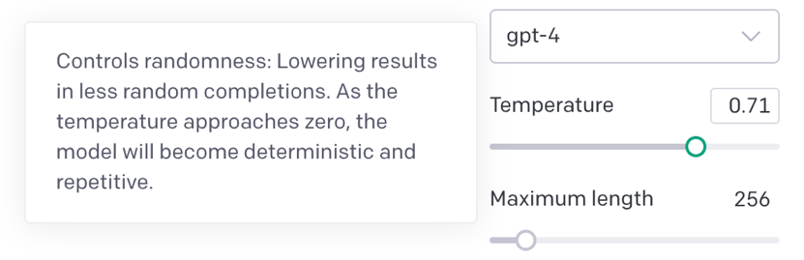
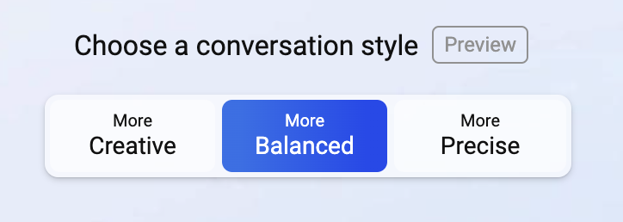
Temperature
Pick a word, but not any word.
Setting the temperature higher asks the model to pick from a wider variety of words as it writes. Great for poems, bad for medical advice.
11

Slide 12
03
Strengths & Weaknesses
Not everything that sounds intelligent, is intelligent

Slide 13
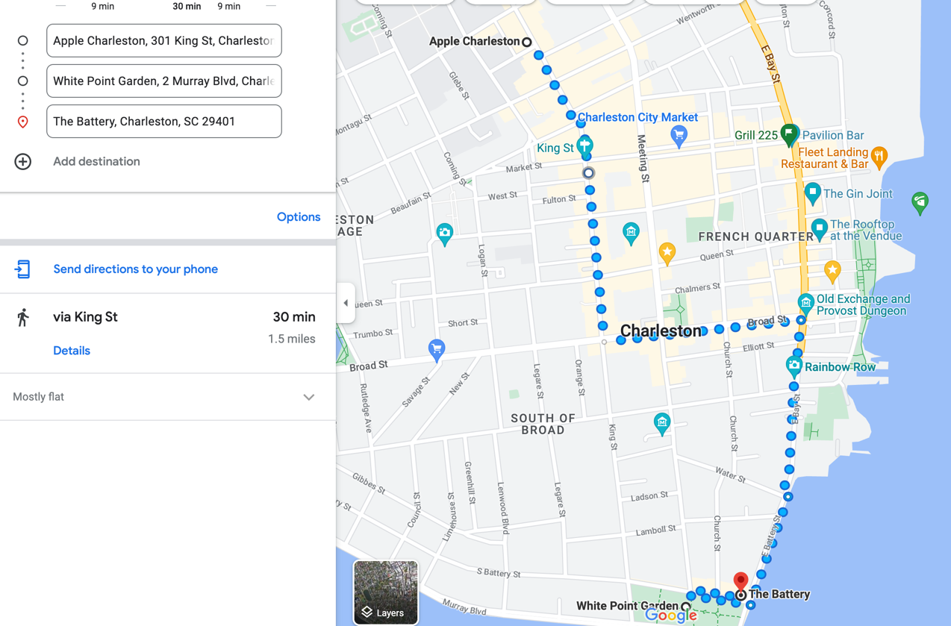
Understanding Hallucinations
GPT is “generative” .. It’s unlikely to say “I don’t know”
Me:
Please write out exact instructions on how to walk from the Apple store on King Street to Battery Park.
GPT
Sure, here are the step-by-step instructions on how to walk from the Apple store on King Street to Battery Park:
Exit the Apple store and turn left onto King Street.
Walk east on King Street for about 2 blocks until you reach Greenwich Street.
Turn right onto Greenwich Street and continue walking south for approximately 8 blocks until you reach Battery Park.
As you approach Battery Park, you will see signs and a map indicating the various attractions and points of interest within the park.
Once you arrive at Battery Park, you can explore the park and its many attractions, including the Battery Gardens restaurant, the SeaGlass Carousel, and the Statue of Liberty ferry terminal.
Note: The walking distance between the Apple store on King Street and Battery Park is approximately 1.2 miles, and the estimated walking time is about 25-30 minutes, depending on your pace.
Me:
Sorry, I meant in Charleston
GPT:
I apologize for the confusion earlier. Here are the step-by-step instructions on how to walk from the Apple store in Charleston to Battery Park:
Exit the Apple store and head south on King Street towards Broad Street.
Turn left onto Broad Street and continue walking east for about 3 blocks.
At the intersection of Broad Street and East Bay Street, turn right onto East Bay Street.
Follow East Bay Street south for approximately 1 mile until you reach the end of the street, where you will see White Point Garden and the entrance to Battery Park.
To enter Battery Park, follow the pathway through White Point Garden towards the water.
Once you arrive at Battery Park, you can explore the park and its many attractions, including the Fort Sumter National Monument, the Charleston Harbor, and the scenic waterfront promenade.
Note: The walking distance between the Apple store in Charleston and Battery Park is approximately 1.2 miles, and the estimated walking time is about 25-30 minutes, depending on your pace.

Slide 14
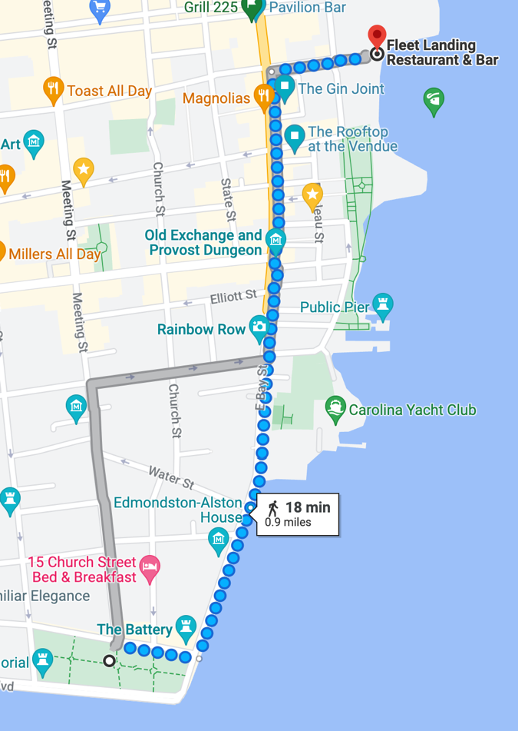
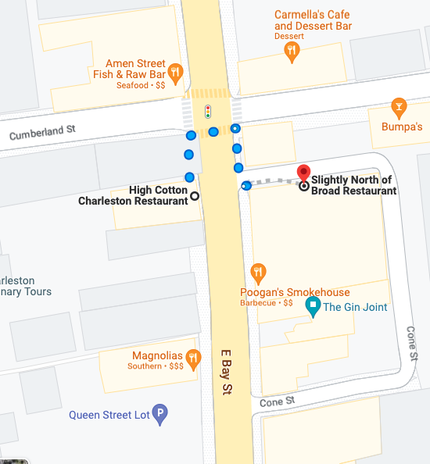
Understanding Hallucinations
Dave Ingram
What restaurants would I pass by along the way?’
GPT
If you're walking from the Apple store on King Street to Battery Park in Charleston, you will pass by several restaurants along the way. Here are some options:
Husk - a popular restaurant featuring Southern cuisine, located at 76 Queen Street, a few blocks south of Broad Street.
82 Queen - another popular restaurant featuring Lowcountry cuisine, located at 82 Queen Street, just a block south of Husk.
Slightly North of Broad (SNOB) - a restaurant featuring modern Southern cuisine, located at 192 E Bay Street, just a block east of the intersection of Broad Street and East Bay Street.
High Cotton - a restaurant featuring classic Southern cuisine, located at 199 E Bay Street, just a block east of SNOB.
Fleet Landing - a seafood restaurant located at 186 Concord Street, just south of White Point Garden and the entrance to Battery Park.
The Southern Grind - a cafe located at 218 Concord Street, just a few steps south of Fleet Landing. They serve coffee, breakfast, and lunch items.
These are just a few of the restaurants you will pass by on your walk from the Apple store to Battery Park in Charleston. There are many other options in the area, so feel free to explore and try something new!

Slide 15
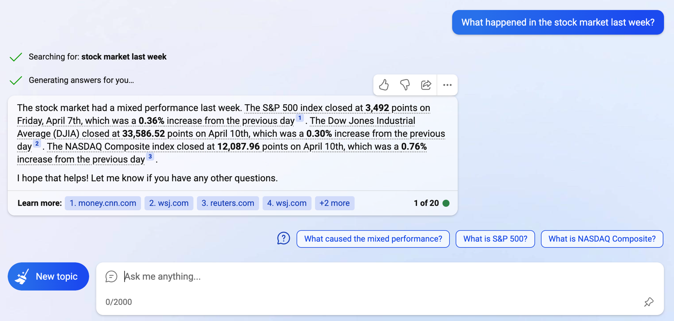
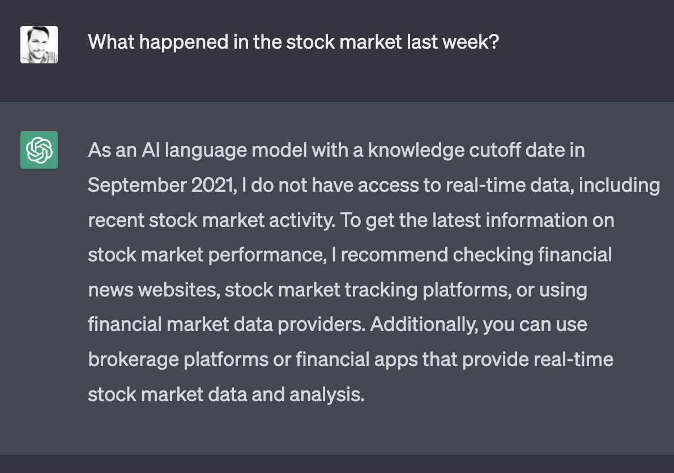
Context is Key

Slide 16
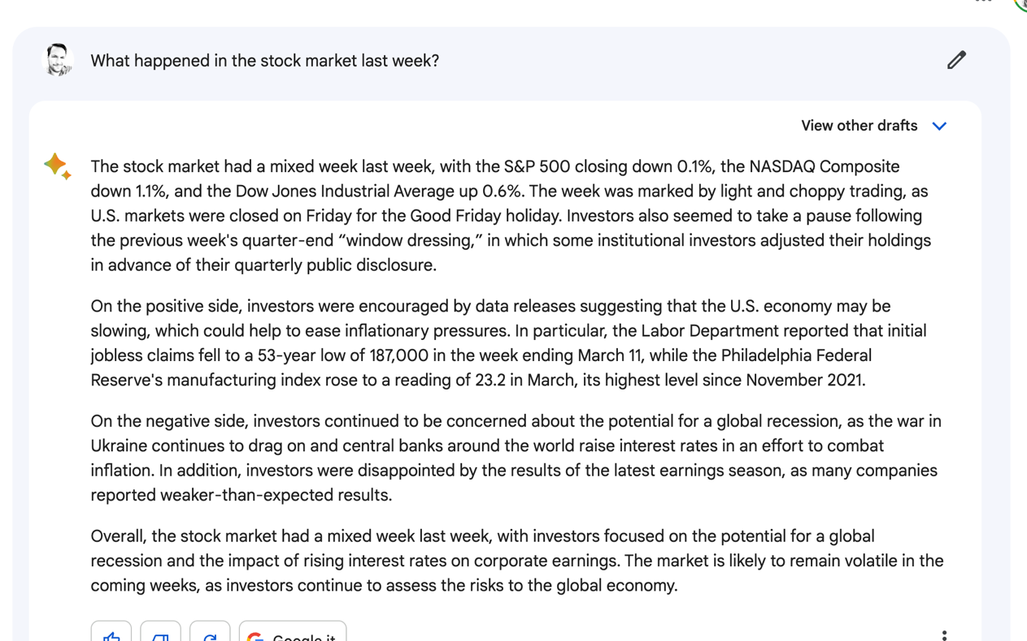
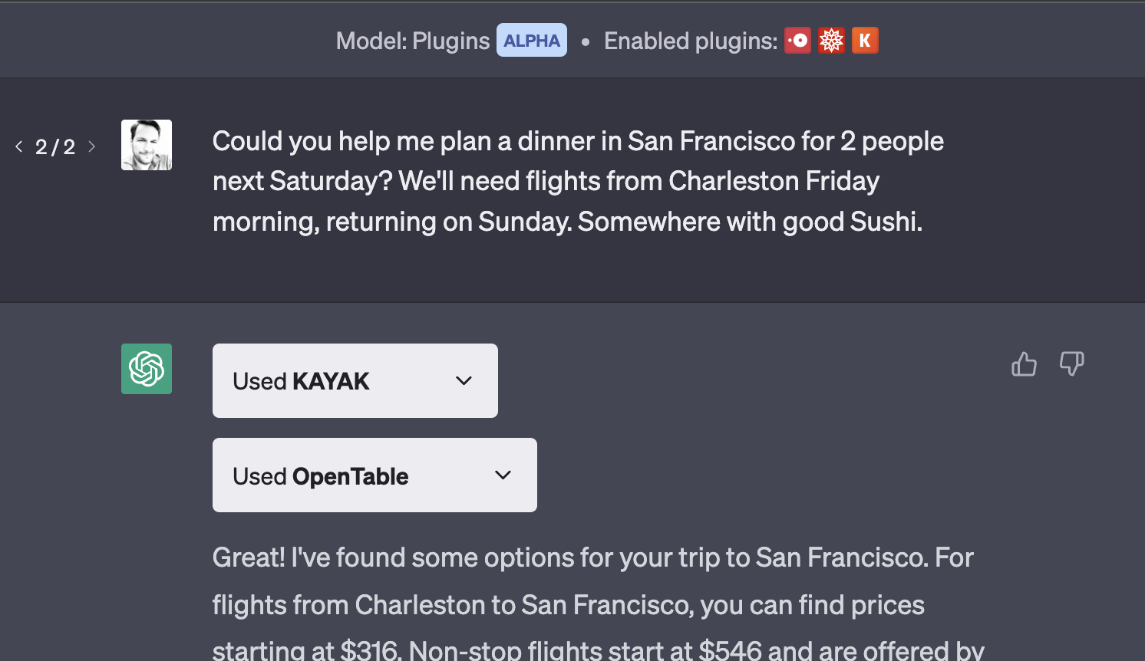
Know your model and its abilities

Slide 17
04
Prompt Engineering
Approaches and methods

Slide 18
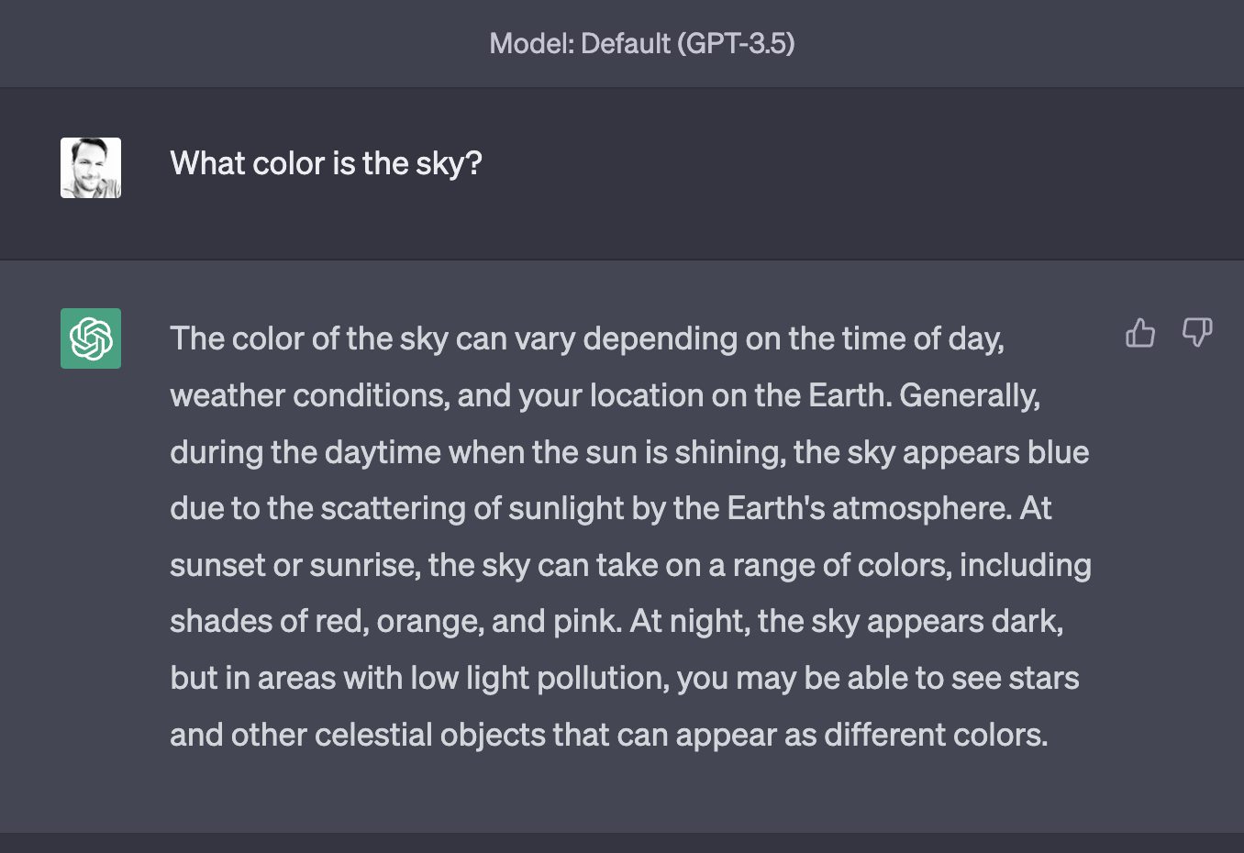
Ask a question

Slide 19
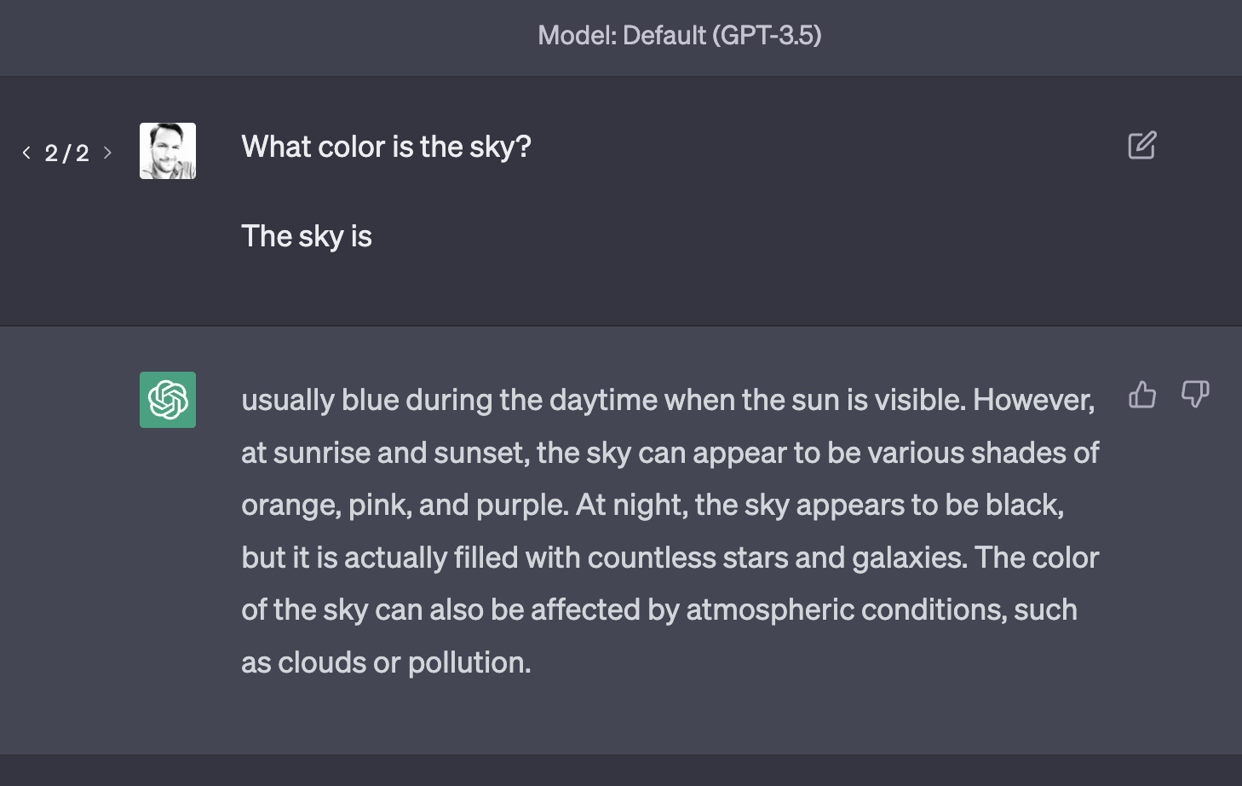
Finish a sentence

Slide 20
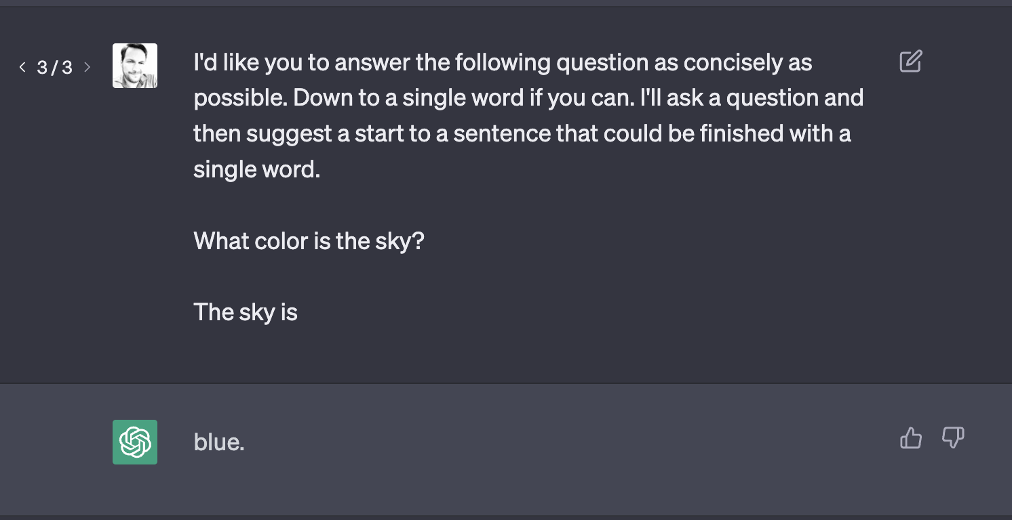
Give instructions

Slide 21
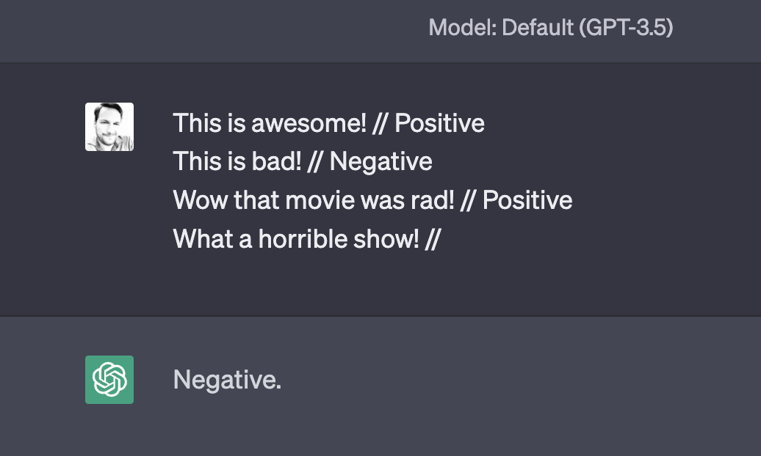
Few-shot prompting
What color is the sky?

Slide 22
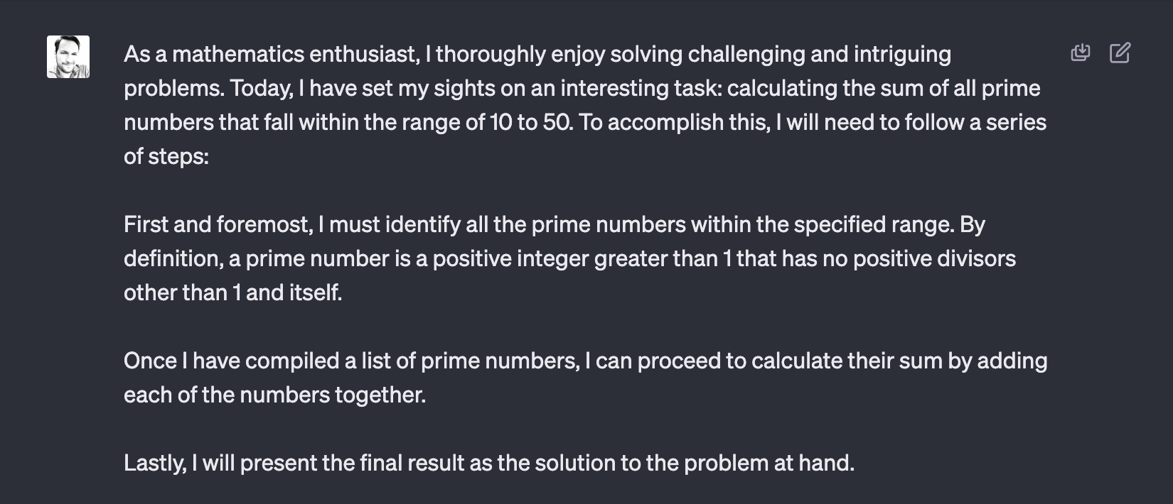
Chain-of-thought prompting
What color is the sky?

Slide 23
Going Further
A prompt can contain any of the following components:
Instruction - a specific task or instruction you want the model to perform
Context - can involve external information or additional context that can steer the model to better responses
Input Data - is the input or question that we are interested to find a response for
Output Indicator - indicates the type or format of the output.
https://www.promptingguide.ai/

Slide 24
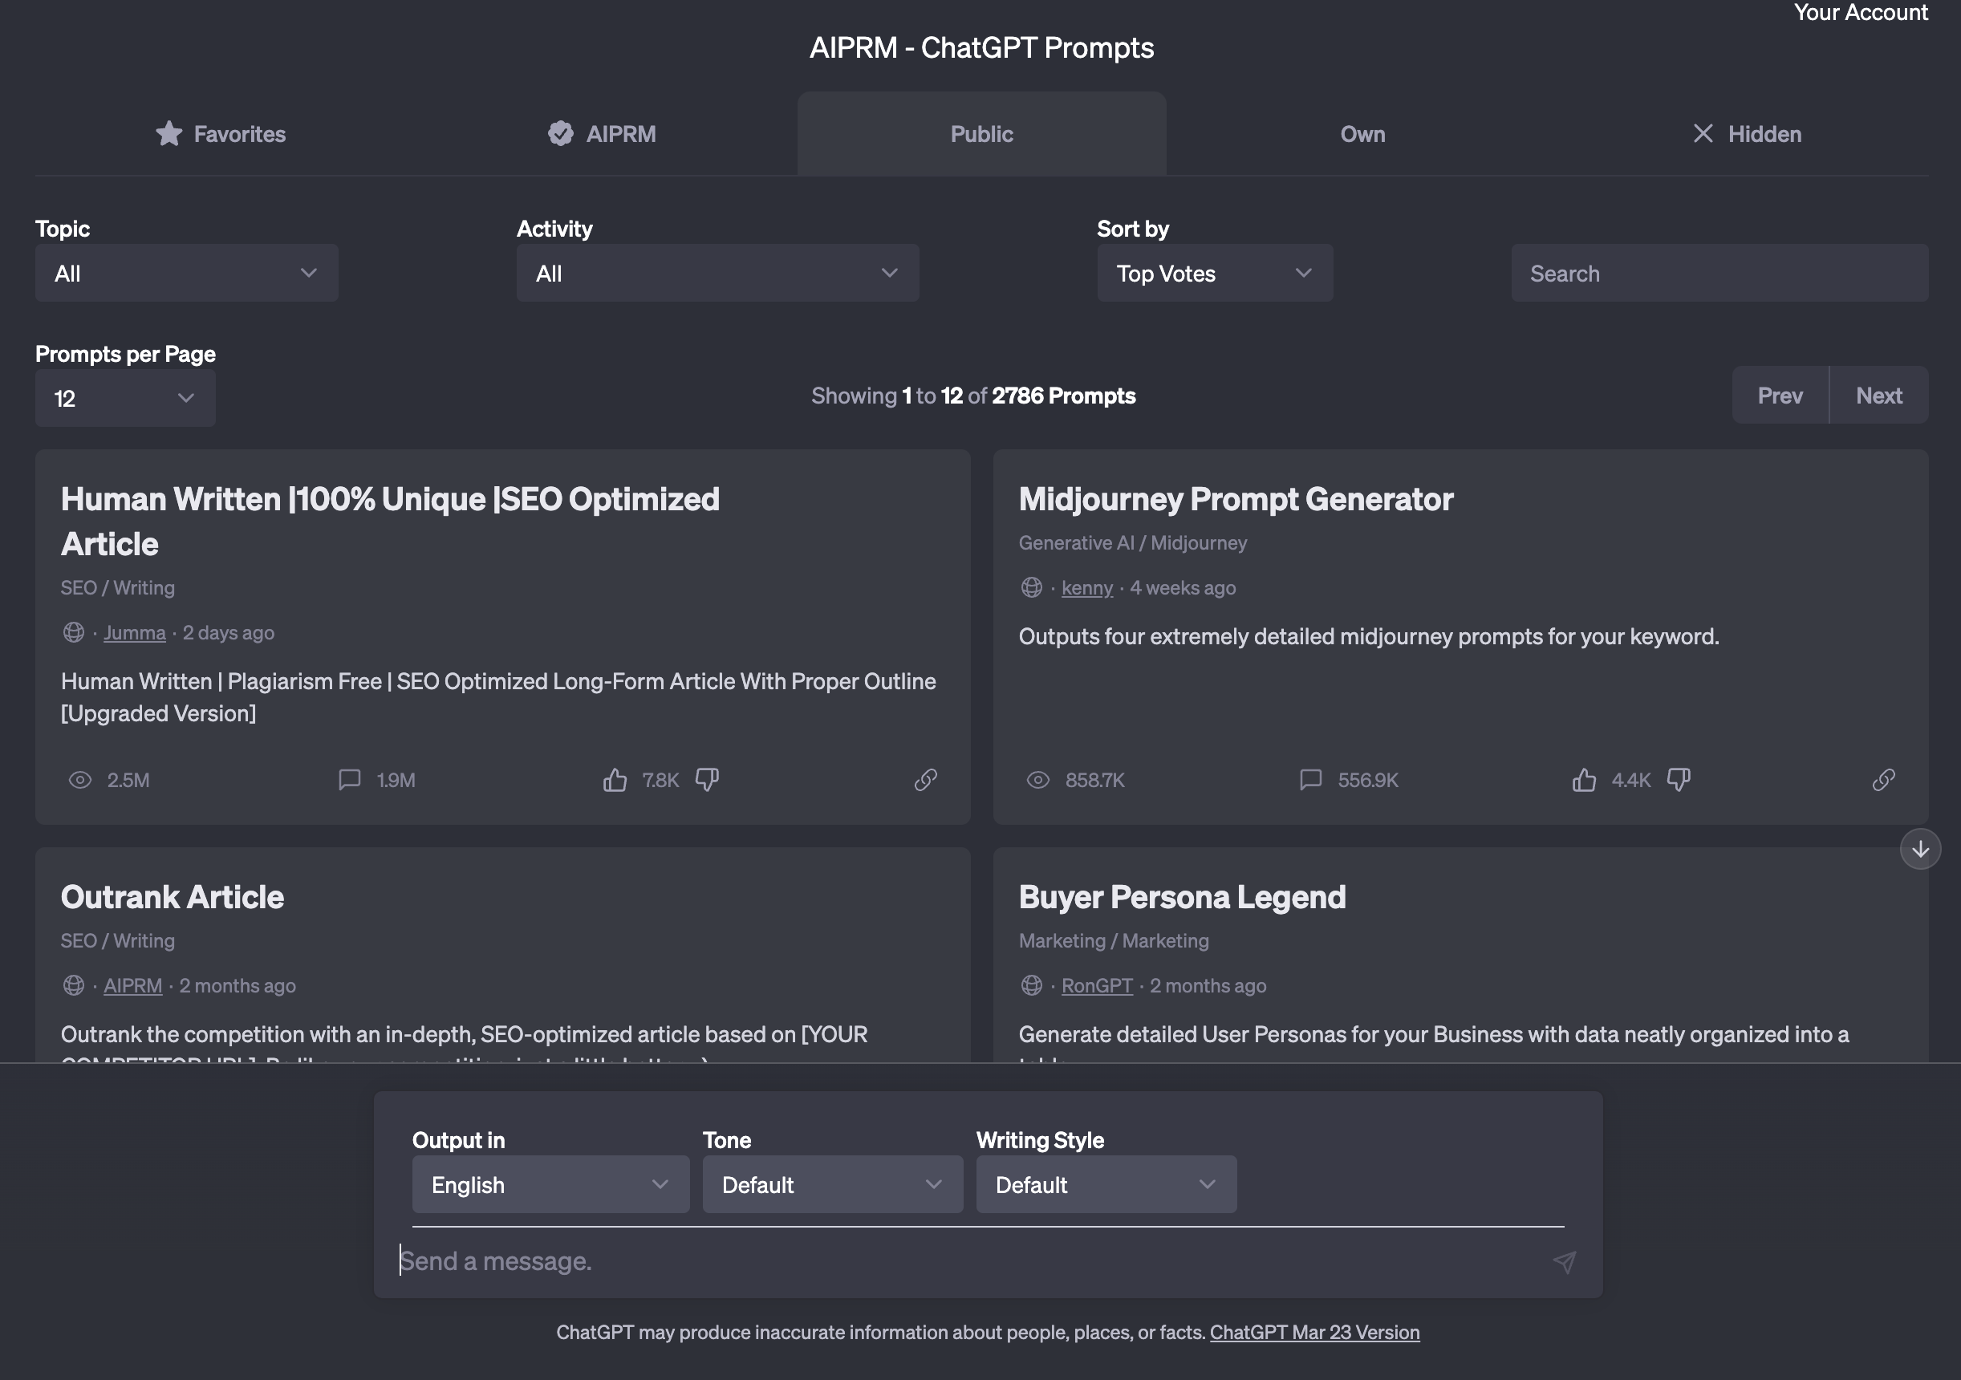
AIPRM

Slide 25

OK, should we write a book now?
Time for some more advanced prompting

Slide 26
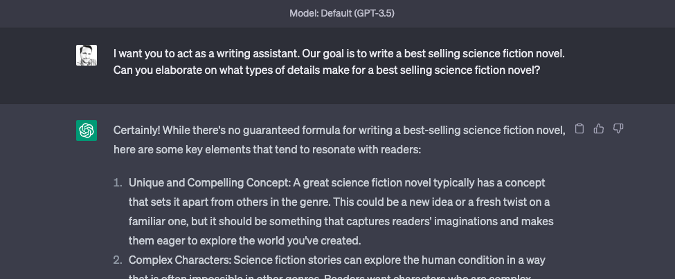
First, let’s set up a goal and context

Slide 27
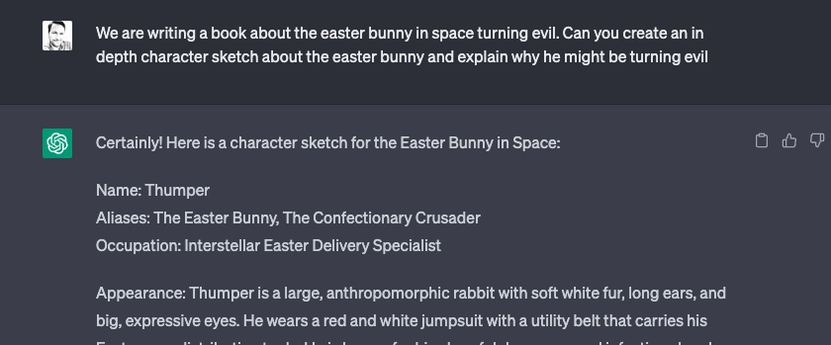
Let’s keep building context…

Slide 28
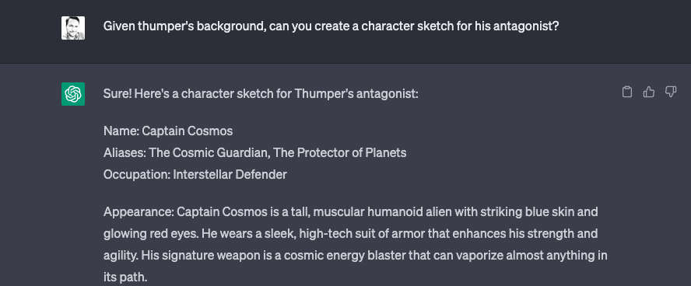
…and some more

Slide 29
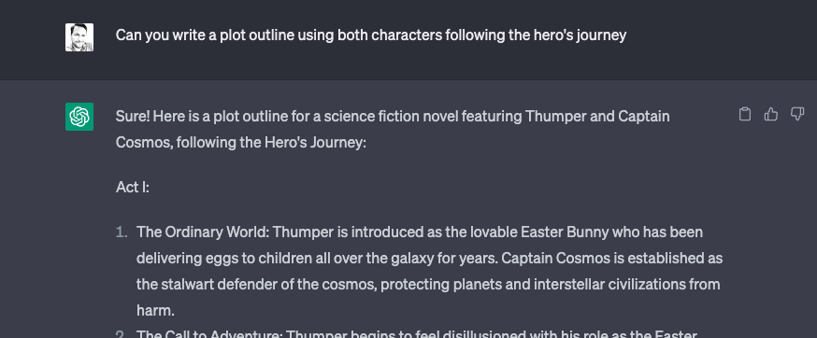
Put past context into some structure

Slide 30
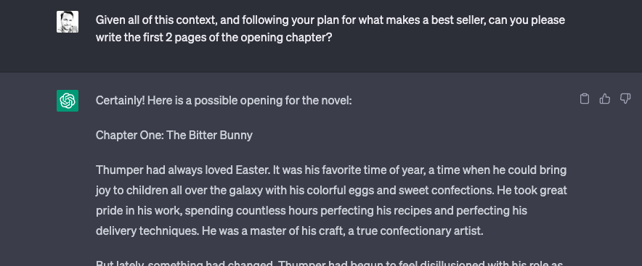
And finally, let’s start writing

Slide 31
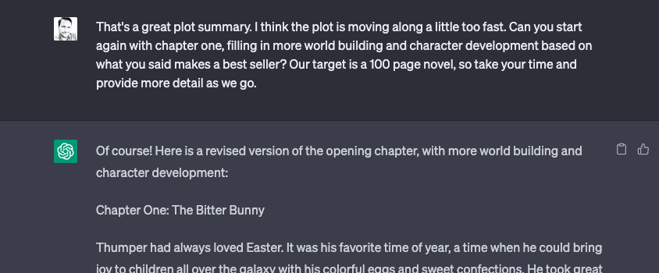
Iterate with constructive feedback

Slide 32
Iterate with constructive feedback

Slide 33
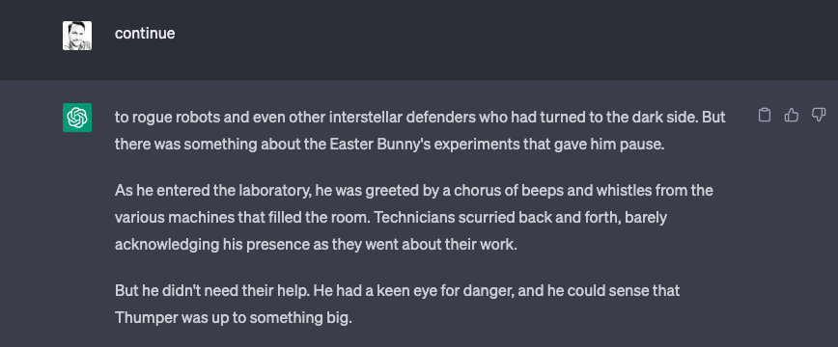
Continuation of long responses

Slide 34
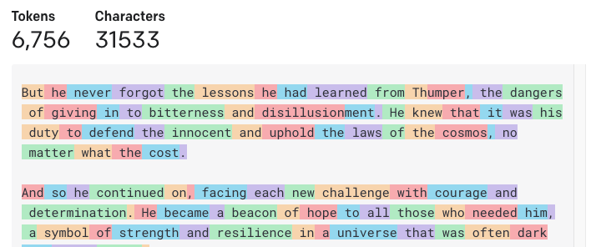
Oh oh. We’ve lost the plot!

Slide 35
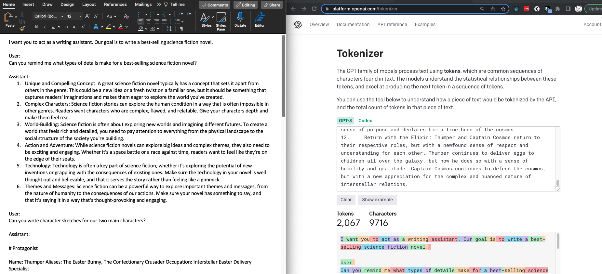
Build a scratch pad summary prompt

Slide 36
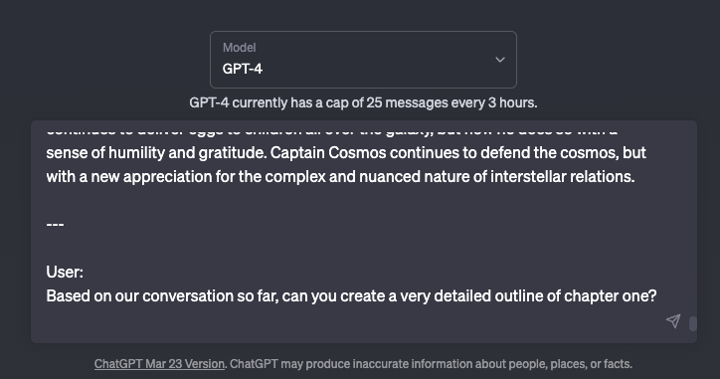
New chat! (with GPT-4 / more context)

Slide 37
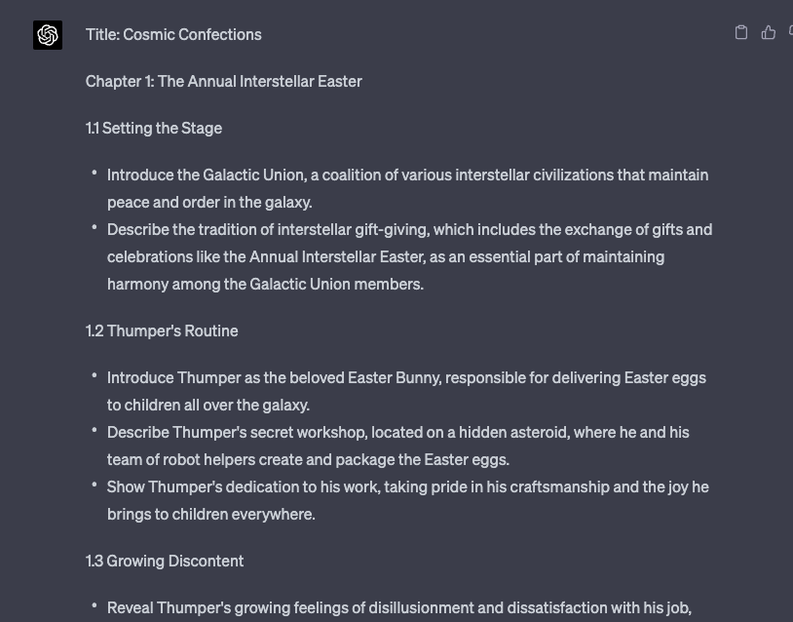
Now we’re getting somewhere!

Slide 38
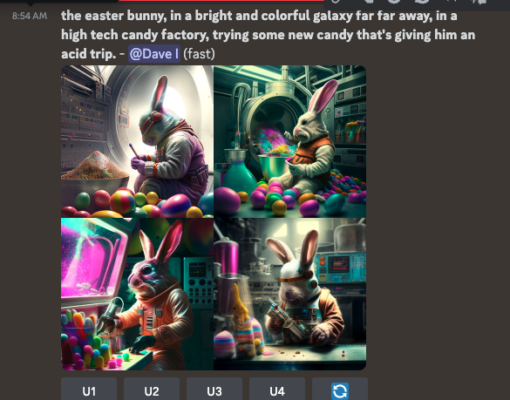
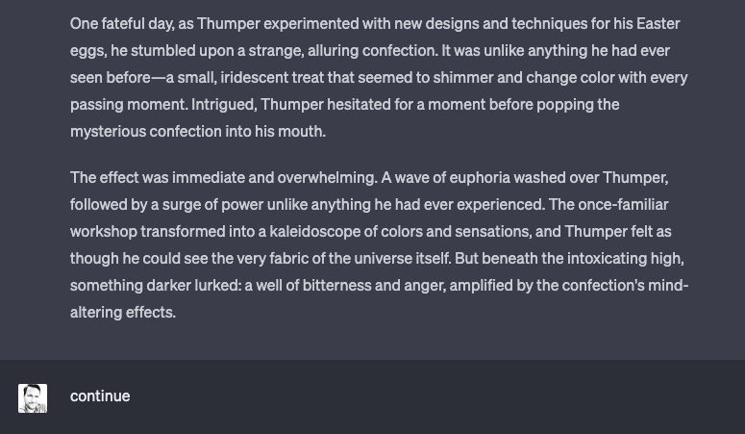
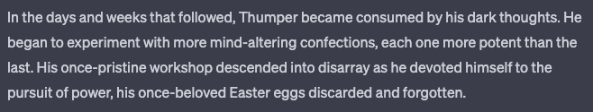
What?!

Slide 39
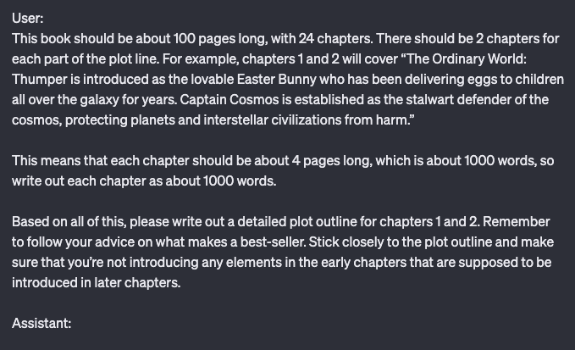
A little more instruction. GPT likes specifics.

Slide 40
How about a Video Game?
Time for some more advanced prompting

Slide 41

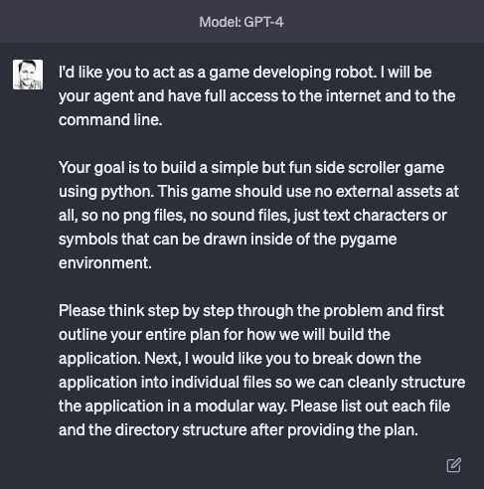
Built in an afternoon…
https://replit.com/@DaveIngram/Squared-Away

Slide 42
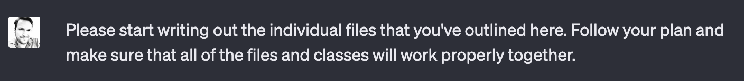
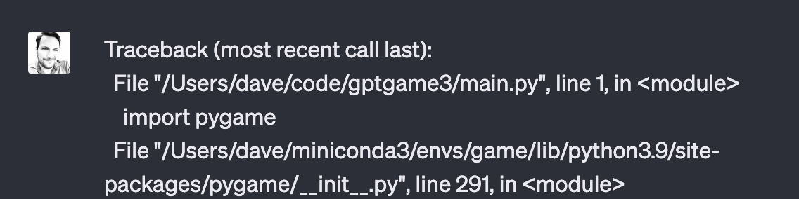

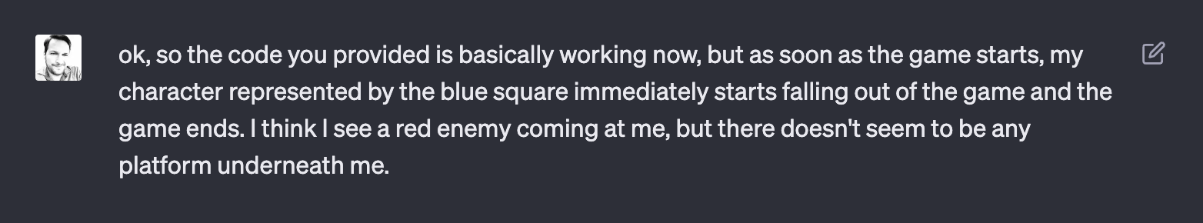

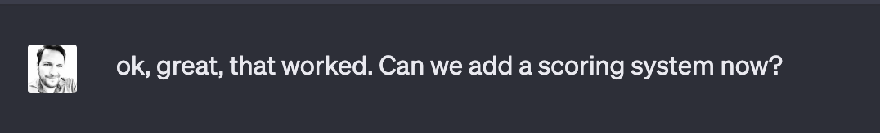

Slide 43
05
Beyond the “chat”
A look at APIs, Plugins and more

Slide 44
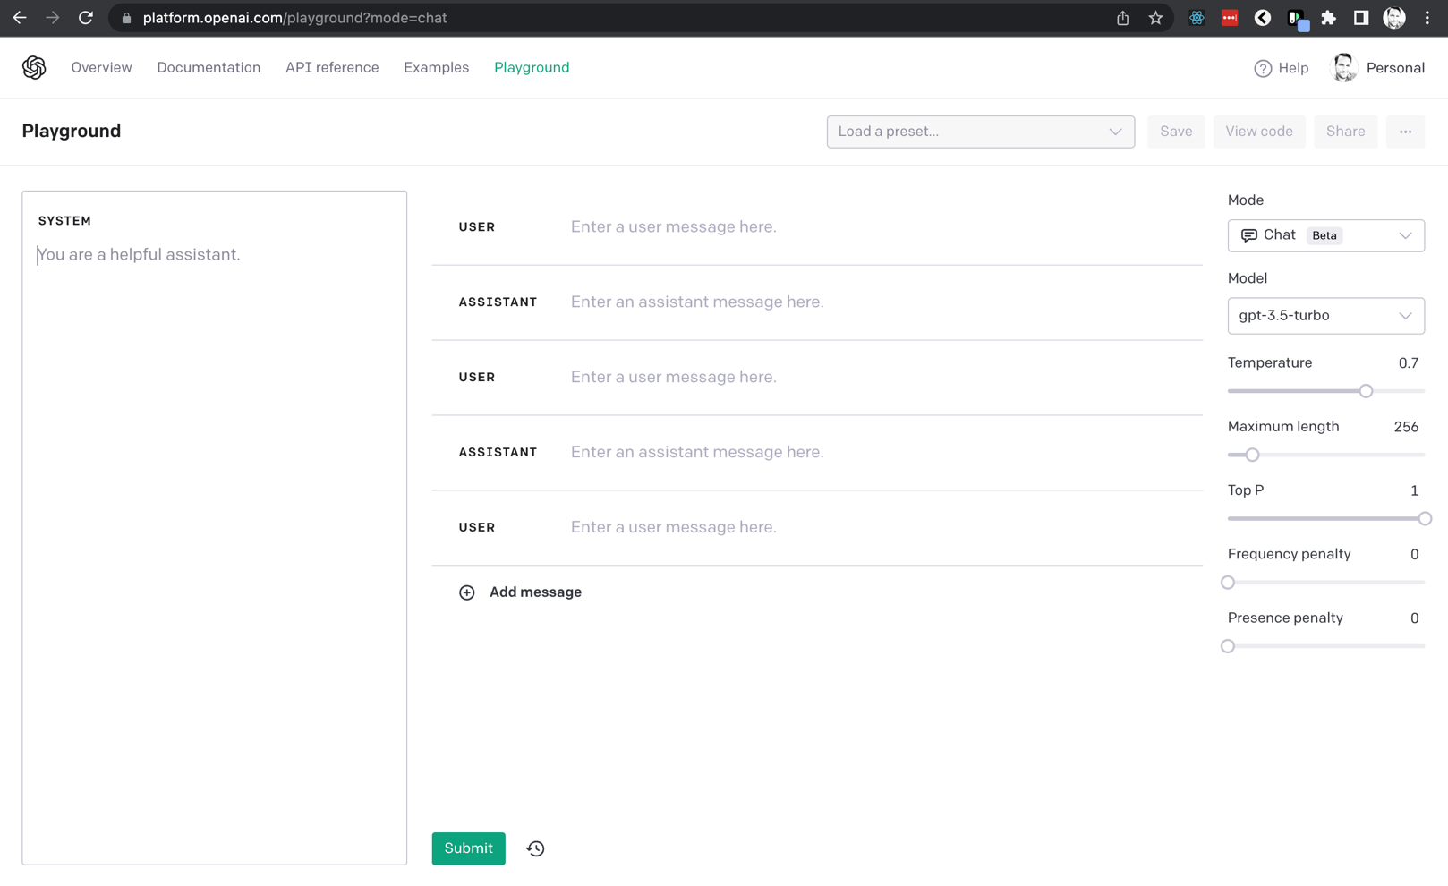
Open AI Playground

Slide 45
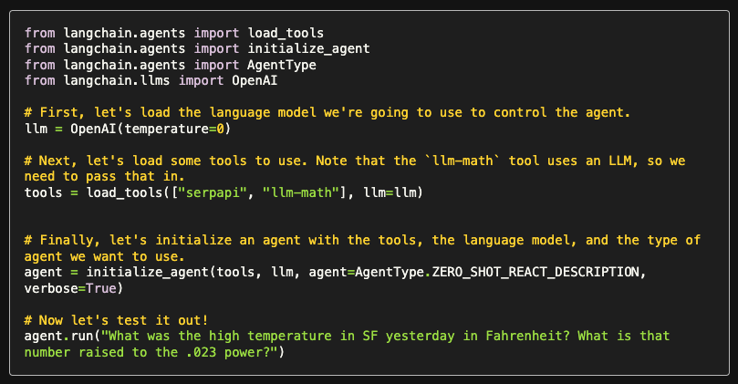
python.langchain.com

Slide 46
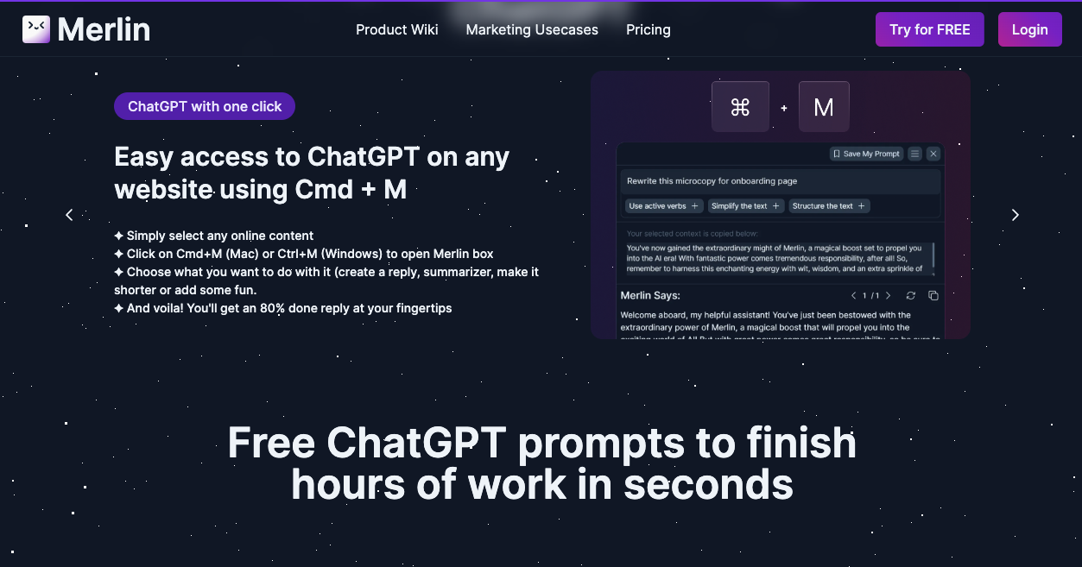
Chrome Extensions like Merlin

Slide 47
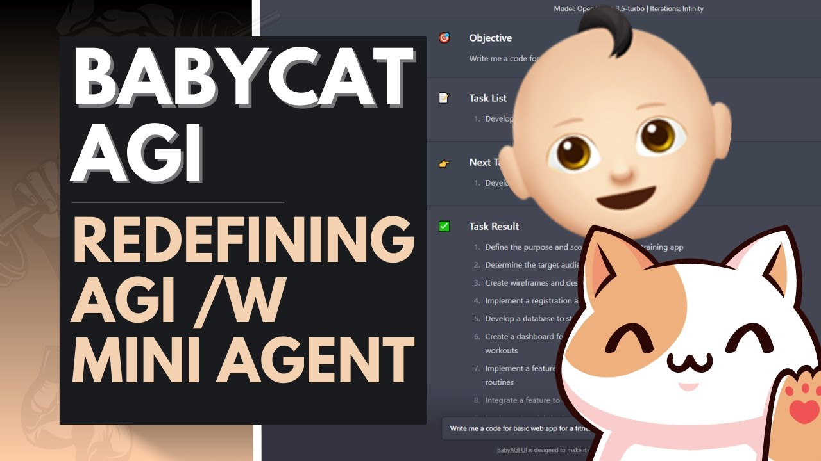
The crazy, whacky world of AutoGPT and Baby Cat AGI

Slide 48
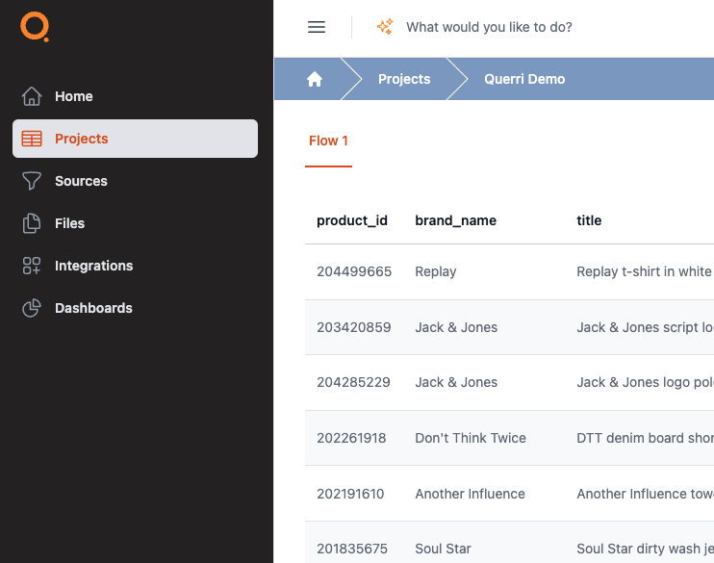
Work with data of any size, using nothing but simple, natural language. We take away data complexity, so you can focus on insight and action. (coming soon.)
GPT prompt automation coming soon as well, plus services available today.

Slide 49
Thanks!
Any questions?
You can find me at:
@daveaingram
dave@querri.com
Slides and resources on Github!

